Slide 1

Module 5
Variable Screening
Notes:
Guidelines
Use section headers to chunk content in your presentation.
Use the same style of section header throughout your presentation.
Keep your title to no more than 2 lines.

Slide 2
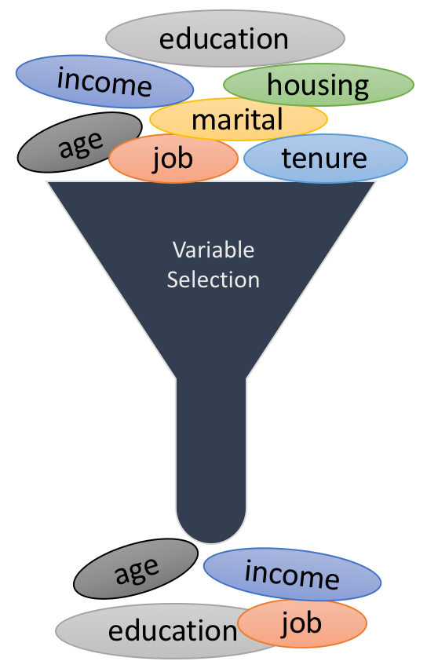
Variable Selection Techniques
Notes:
Guidelines
Use a title slide at the beginning of your presentation. There are 9 variations of title slides to choose from.
If you will have a series of slideshows, we recommend using the same style of title slide for each presentation.
Keep your title to no more than 2 lines.
Do not change the font style or font size of the title or subtitle.

Slide 3
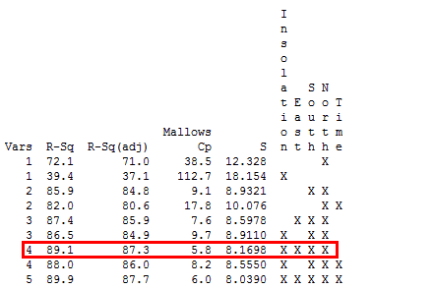
All-Subsets Regression
Tests all possible subsets of the set of potential independent variables.

Slide 4
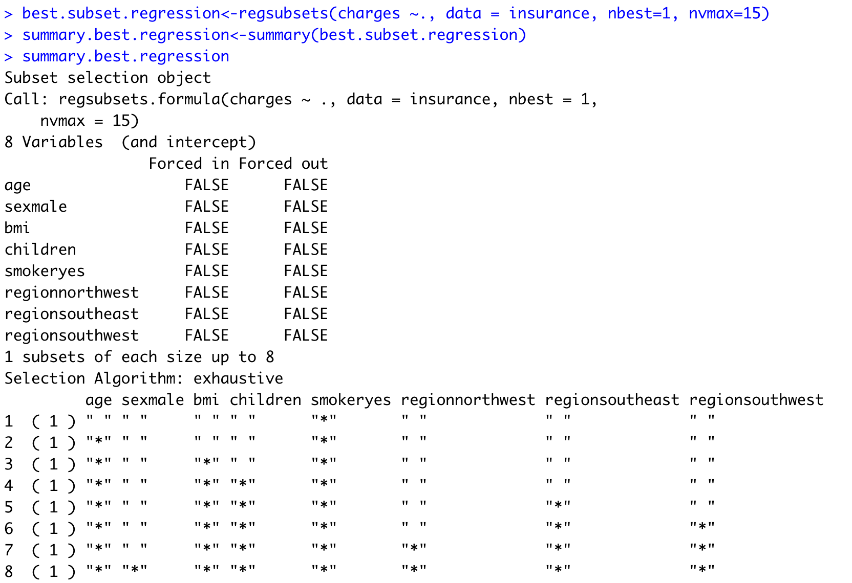
All-Subsets Regression
Tests all possible subsets of the set of potential independent variables.

Slide 5
All-Subsets Regression

Slide 6

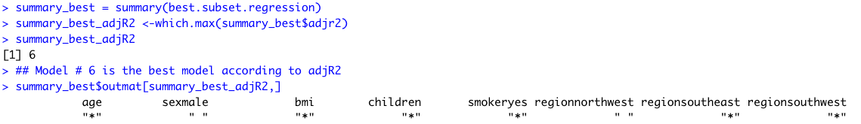
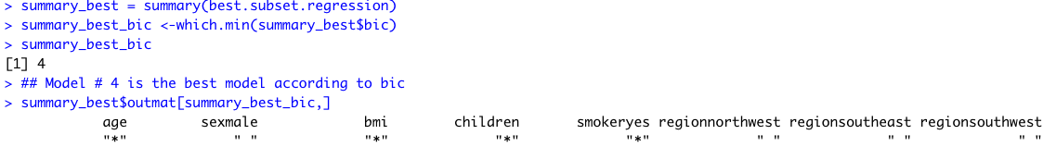
All-Subsets Regression
You can rank-order Best Models According to:
Example Based on Adj-R2:
Example Based on BIC:

Slide 7
High-Dimensional

Slide 8
Variable Selection Techniques
Notes:
Guidelines
Use a title slide at the beginning of your presentation. There are 9 variations of title slides to choose from.
If you will have a series of slideshows, we recommend using the same style of title slide for each presentation.
Keep your title to no more than 2 lines.
Do not change the font style or font size of the title or subtitle.

Slide 9
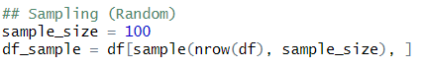
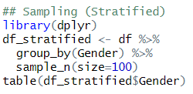
High # of Observations
In a statistical study, sampling is used to select observations from a dataset to be in the study.
Sampling can be done randomly, e.g.,:
We can also do stratified sampling, e.g.,:

Slide 10
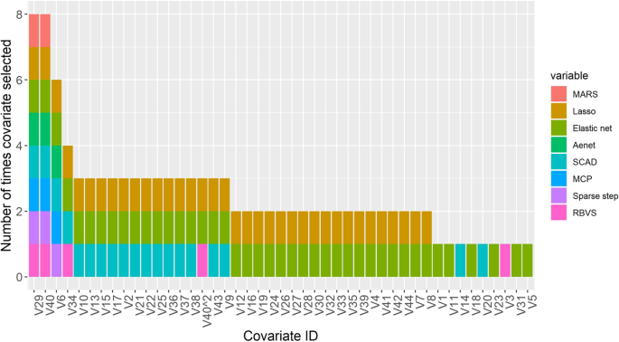
High # of Variables
We need more efficient variable screening algorithms

Slide 11
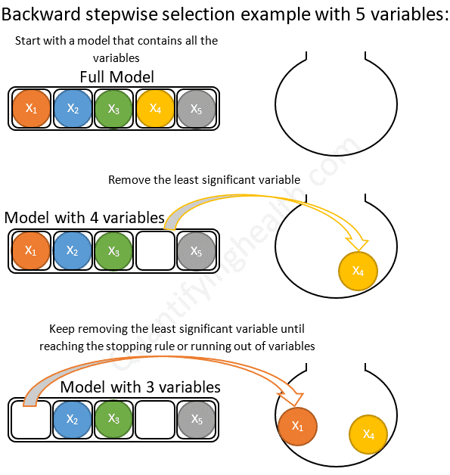
Backward Variable Screning

Slide 12
Backward Variable Screening
You must create the following regressions prior to running the function.
Create the intercept only model, the model with no predictors in it. It will always look like this: null=lm(Y~1,data=data)
Create the model containing all of the possible effects. Use this syntax full=lm(f,data=data) where f is a formula object you create depending on the model that you would like to fit (see the document “Formulas in R.docx”).
Once you have the null and full model created you can perform the stepwise selection with:
Backward.reg<-step(full,scope=list(lower=null,upper=full),direction= “backward”, trace=2, k=2)
Trace = 2: prints more information. The higher the trace the more info the output prints
k=2: Selection based on AIC. k = log(n): selection based on BIC
where scope() gives the upper and lower bounds on the model selection.

Slide 13
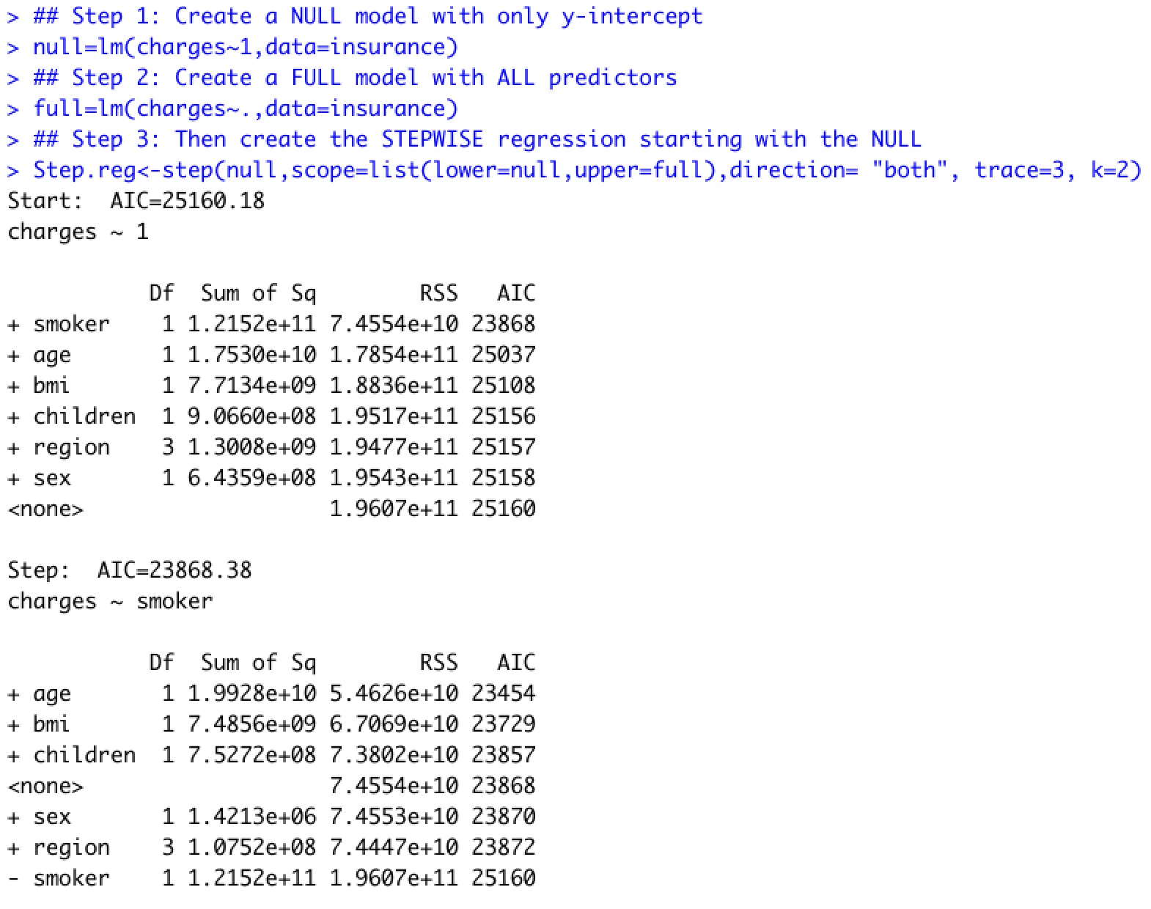
Stepwise Variable Screening

Slide 14
Forward Variable Screening

Slide 15
Forward Variable Screening
You must create the following regressions prior to running the function.
Create the intercept only model, the model with no predictors in it. It will always look like this: null=lm(Y~1,data=data)
Create the model containing all of the possible effects. Use this syntax full=lm(f,data=data) where f is a formula object you create depending on the model that you would like to fit (see the document “Formulas in R.docx”).
Once you have the null and full model created you can perform the stepwise selection with:
Forward.reg<-step(null,scope=list(lower=null,upper=full),direction= “forward”, trace=2, k=2)
Trace = 2: prints more information. The higher the trace the more info the output prints
k=2: Selection based on AIC. k = log(n): selection based on BIC
where scope() gives the upper and lower bounds on the model selection.

Slide 16
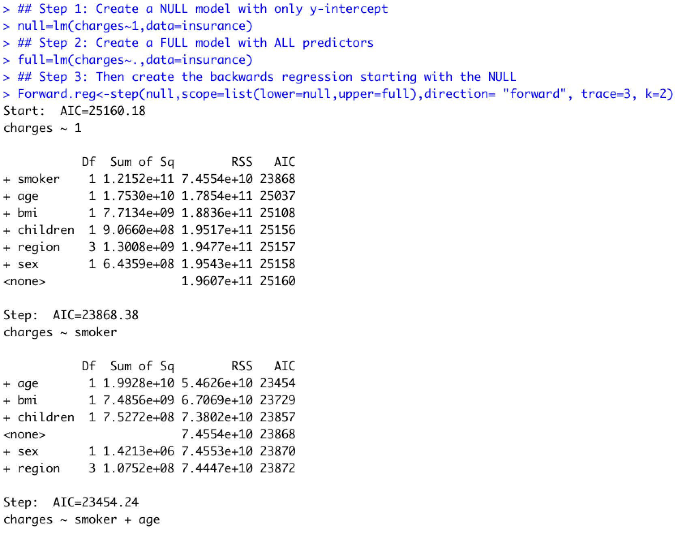
Forward Variable Screening

Slide 17
Stepwise Variable Screening
Variables Can Also be Dropped

Slide 18
Stepwise Variable Screening
You must create the following regressions prior to running the function.
Create the intercept only model, the model with no predictors in it. It will always look like this: null=lm(Y~1,data=data)
Create the model containing all of the possible effects. Use this syntax full=lm(f,data=data) where f is a formula object you create depending on the model that you would like to fit (see the document “Formulas in R.docx”).
Once you have the null and full model created you can perform the stepwise selection with:
Stepwise.reg<-step(null,scope=list(lower=null,upper=full),direction= “both”, trace=2, k=2)
Trace = 2: prints more information. The higher the trace the more info the output prints
k=2: Selection based on AIC. k = log(n): selection based on BIC
where scope() gives the upper and lower bounds on the model selection.

Slide 19
Backward Variable Screening

Slide 20
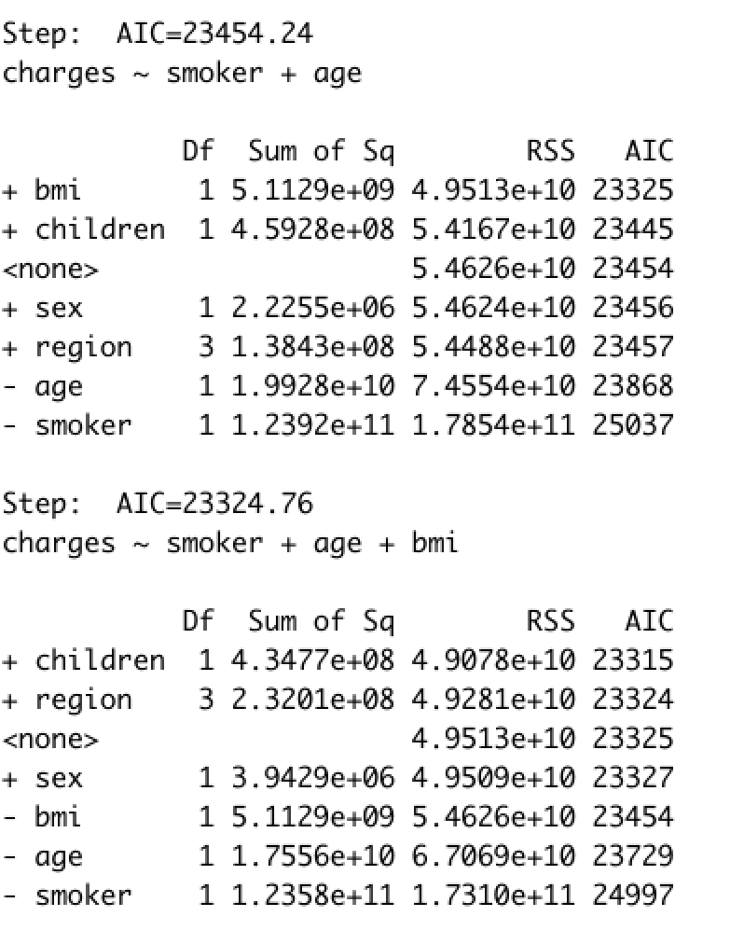
Backward Variable Screening

Slide 21
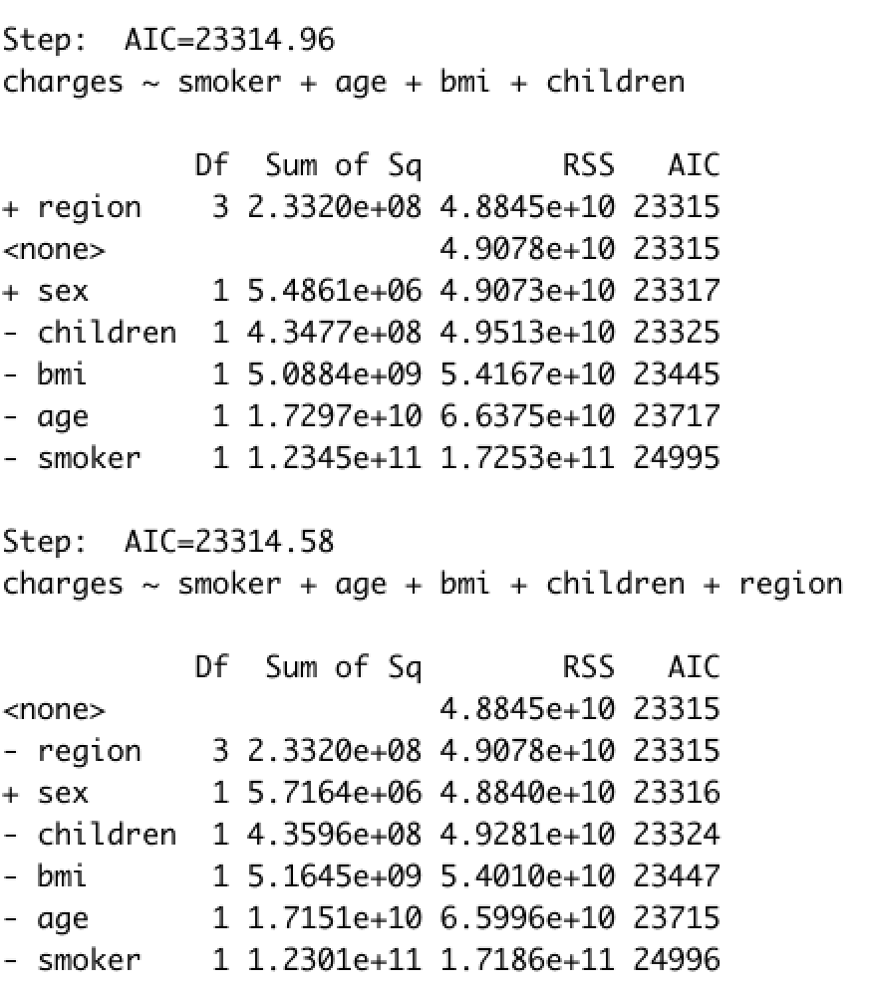
Backward Variable Screening

